Slide 1
Project Scheduling using CPM & PERT
M K Hamirwasia
WILPD

Slide 2
AE ZG523/DE ZG523/ES ZG523/MM ZG523/POM ZG523-Merged
Project Management
Lecture No. 8

Slide 3
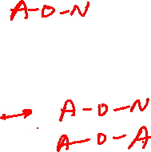
PROJECT NETWORK PLANNING
  Critical Path Method (CPM) – Project Crashing
  Program/Project Evaluation and Review Technique (PERT)

Slide 4
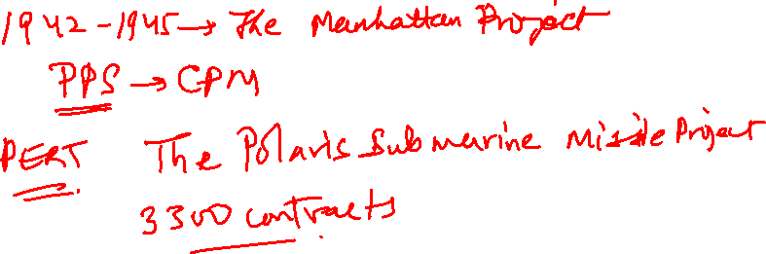

Slide 5
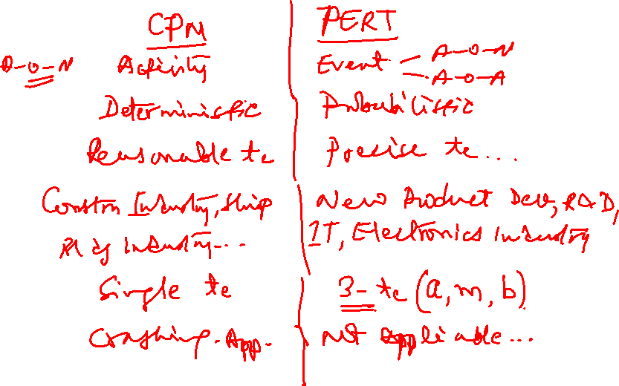

Slide 6
PERT
(PROGRAM EVALUATION & REVIEW TECHNIQUE)
In 1958 the Special Office of the US Navy and the Booz, Allen, and Hamilton consulting firm developed PERT to schedule the more than 3,300 contracts of the Polaris submarine project and to cover uncertainty of activity time estimates.
PERT is almost identical to the critical path method (CPM) except it assumes each activity duration has a range that follows a statistical distribution.

Slide 7
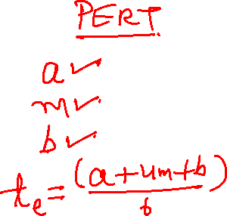

Slide 8
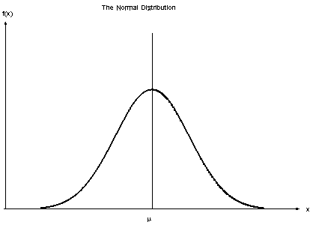
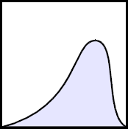
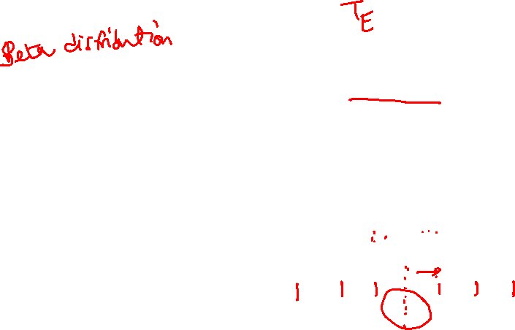
Activity and Project Frequency Distributions
Activity
Project
a
m
b
T_{E}

Slide 9

Weighted Average Activity Time (te)
        a + 4m + b
te = -------------
6
te = weighted average activity time
a = optimistic activity time (1 chance in 100 of completing the activity earlier under normal
conditions)
b = pessimistic activity time (1 chance in 100 of completing the activity later under normal
conditions
m = most likely activity time

Slide 10
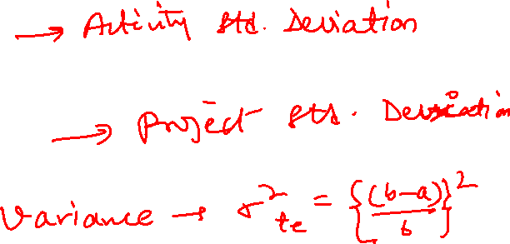
Standard Deviation
  σt_{e} = ( b – a)
  6
  σT_{E} = √ ∑ (σt_{e} )²

Slide 11
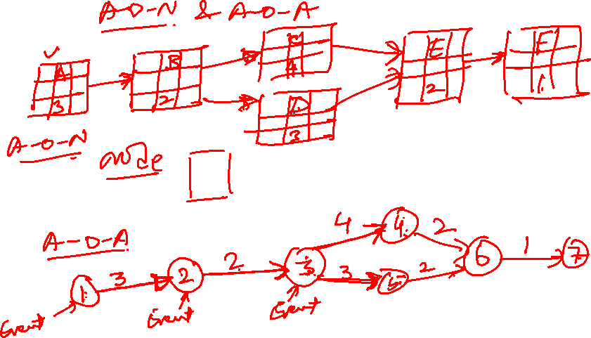

Slide 12
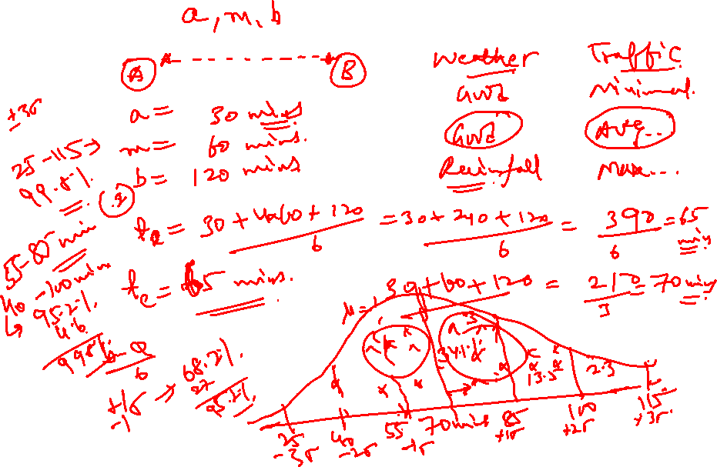

Slide 13
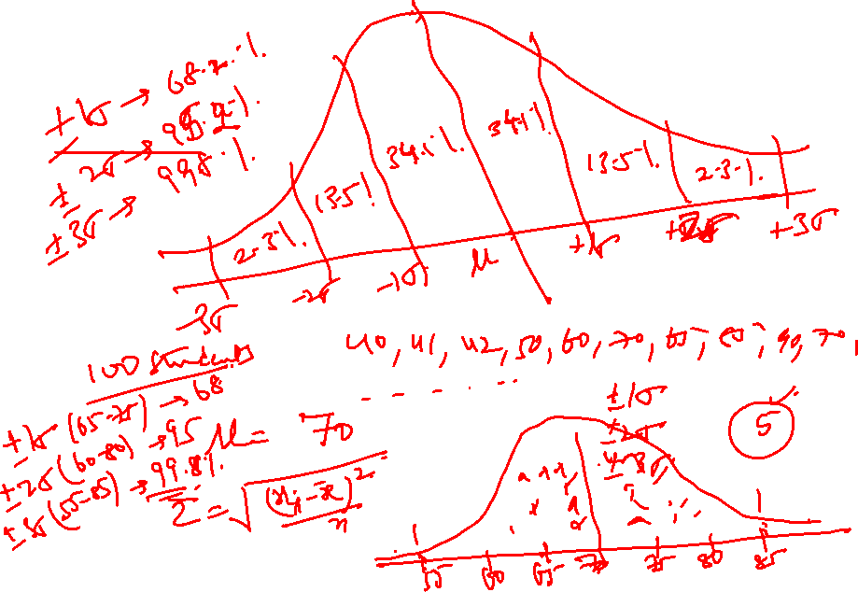

Slide 14

Probability of Completing the Project in Time
Ts – TE
Z = --------------
√ ∑ (σt_{e} )²
T_{E} = Critical path duration
T_{S} = Scheduled project duration
Z = probability (of meeting scheduled duration) found in statistical Table A7.2

Slide 15
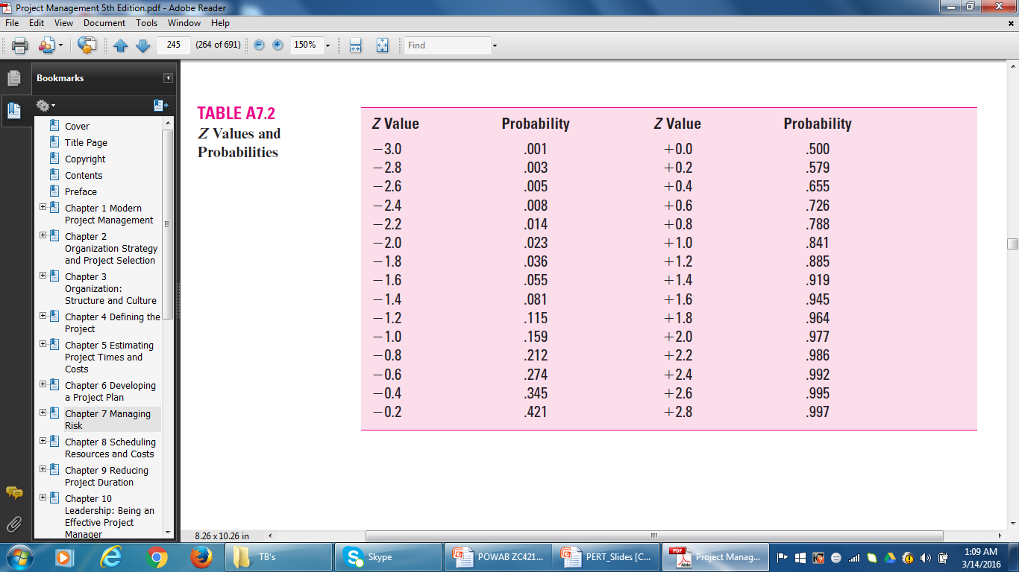
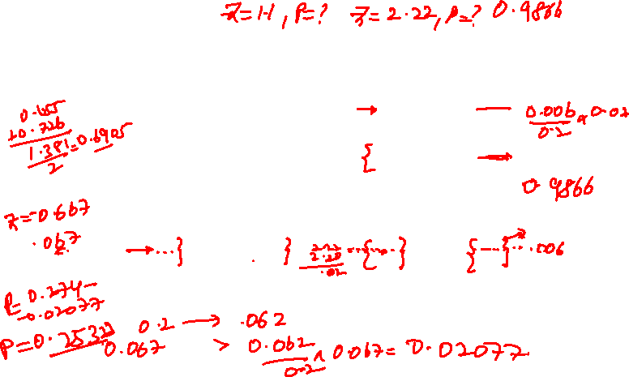
Z Values and Probabilities

Slide 16
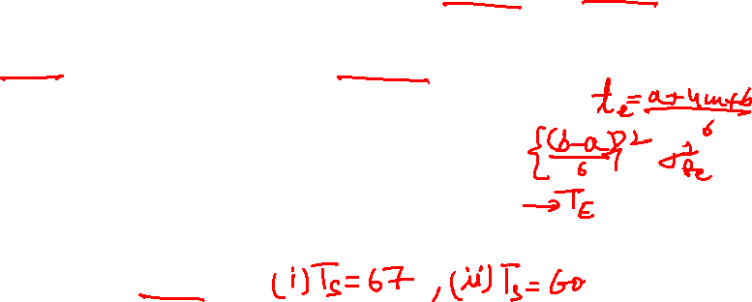
A HYPOTHETICAL EXAMPLE USING THE PERT TECHNIQUE
The activity times and variances are given in Table A7.1. The project network is presented in Figure A7.2. This figure shows the project network as AOA and AON. The AON network is presented as a reminder that PERT can use AON networks as well as AOA.
1. Compute the expected time for each activity.
2. Compute the variance for each activity.
3. Compute the expected project duration.
4. What is the probability of completing the project by day 67? Within 60 days?

Slide 17
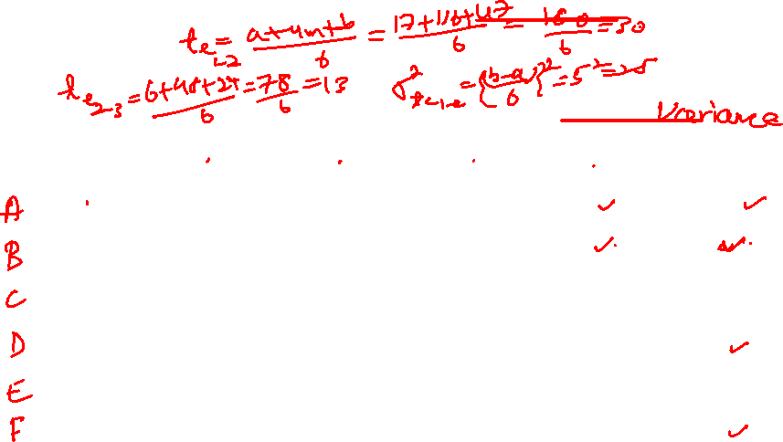
PERT Example

Slide 18
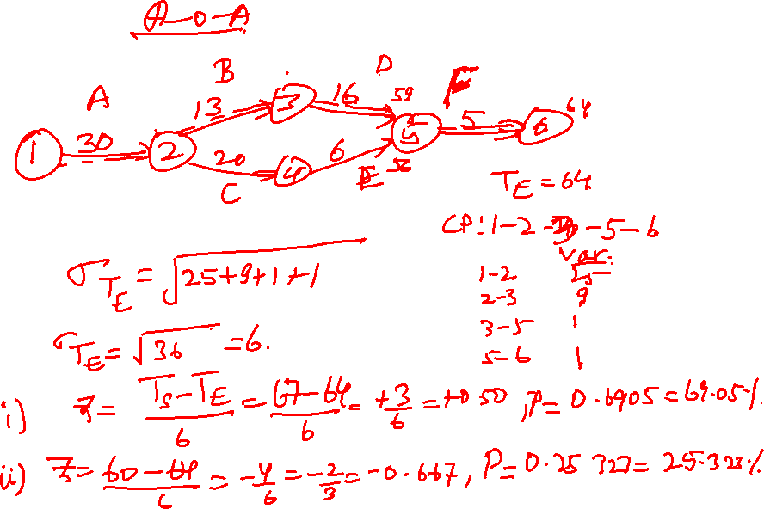

Slide 19
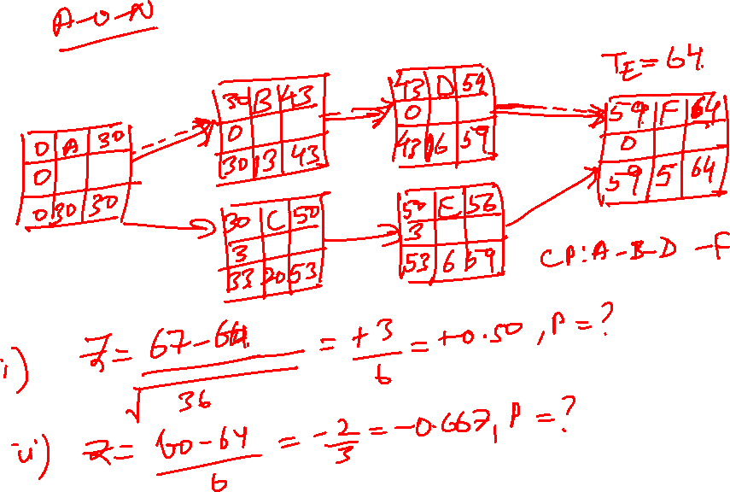

Slide 20
Z Values and Probabilities

Slide 21
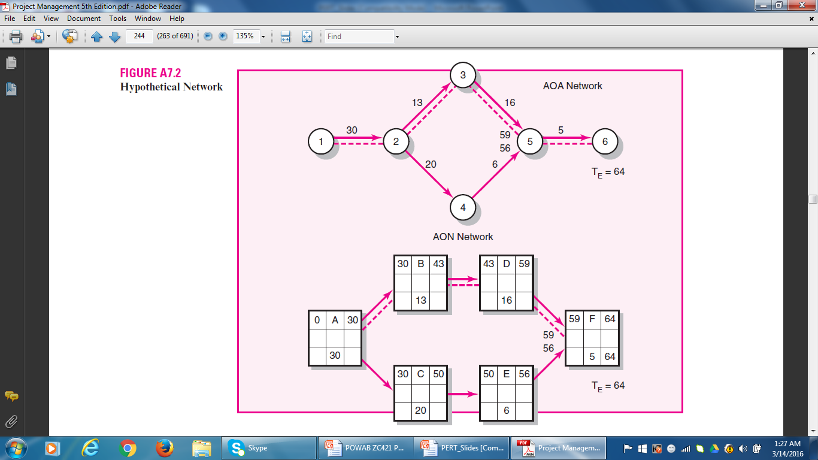
PERT Example

Slide 22
Probability of completing the project in 67 days
Ts – TE
Z = --------------
√ ∑ (σ_{te} )²
        67 – 64 + 3
Z = ----------------- = -------- = + 0.50
√ 25 + 9 + 1 + 1 √ 36
P = 0.69 (69 percent chance of completing the project on or before 67 time units)

Slide 23
Probability of completing the project in 60 days
Ts – TE
Z = --------------
√ ∑ (σ_{te} )²
        60 – 64 - 4
Z = ----------------- = -------- = - 0.67
√ 25 + 9 + 1 + 1 √ 36
P = 0.26 (26 percent chance of completing the project on or before 60 time units)

Slide 24
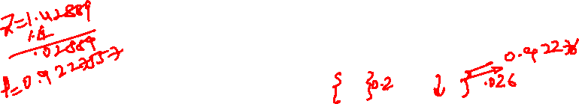
Z Values and Probabilities

Slide 25
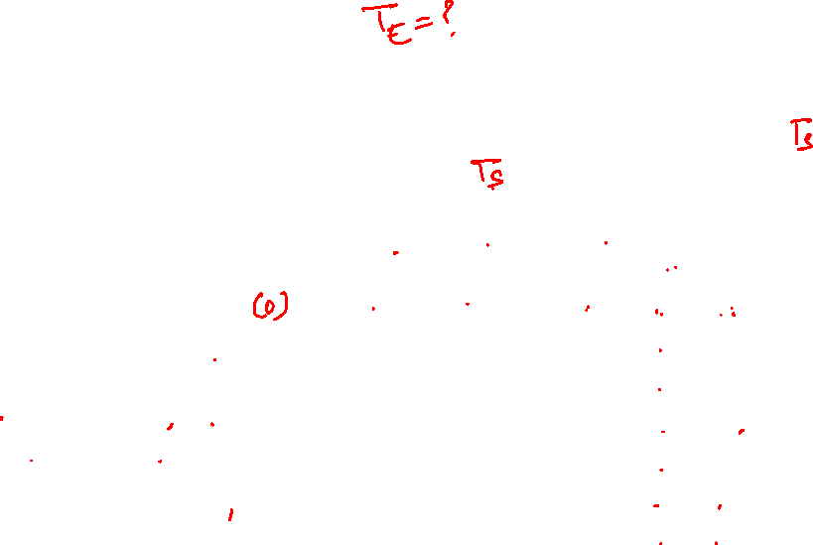
Exercise 1
Given the project information below, what is the probability of completing the National Holiday Toy project in (i) 93 time units? (ii) in 88 time units?
Act ID(i) | Description | Predecessor | Optm. (a) | Most likely (m) | Pess. (b) | Act. Time (t_{e}) | Variance {(b-a)/6}² | Critical
1 | Design Package | None | 6 | 12 | 24 | 13 | 9 | Y
2 | Design product | 1 | 16 | 19 | 28 | 20 | 4 | Y
3 | Build package | 1 | 4 | 7 | 10 | 7 | 1 | N
4 | Secure patent | 2 | 21 | 30 | 39 | 30 | 9 | Y
5 | Build product | 2 | 17 | 29 | 47 | 30 | 25 | Y
6 | Paint | 3, 4,5 | 4 | 7 | 10 | 7 | 1 | N, Y, Y
7 | Test market | 6 | 13 | 16 | 19 | 16 | 1 | Y

Slide 26
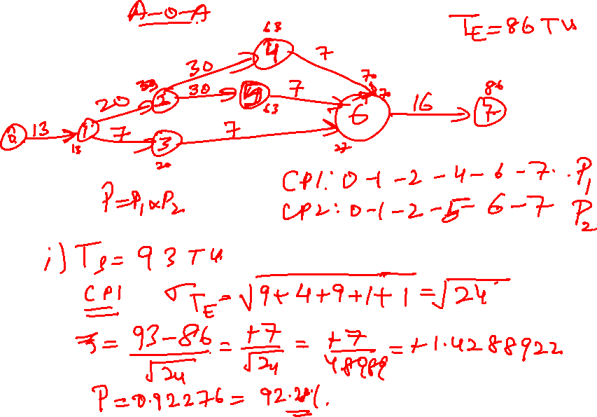

Slide 27
Exercise 1 (A-O-A)
CP₁: 0-1-2-4-6-7 (86)
CP₂: 0-1-2-5-6-7 (86)
4
T_{E1} = 86 Weeks
30
7
T_{E2} = 86
13
20
30
0
1
7
16
2
5
6
7
7
7
3
T_{E3} = 43

Slide 28
A-O-N
Act ID | Description | Predecessor | Optm. (a) | Most likely (m) | Pess. (b) | Act. Time (t_{e}) | Variance {(b-a)/6}² | Critical
A | Design Package | None | 6 | 12 | 24 | 13 | 9 | Y
B | Design product | A | 16 | 19 | 28 | 20 | 4 | Y
C | Build package | A | 4 | 7 | 10 | 7 | 1 | N
D | Secure patent | B | 21 | 30 | 39 | 30 | 9 | Y
E | Build product | B | 17 | 29 | 47 | 30 | 25 | Y
F | Paint | C, D, E | 4 | 7 | 10 | 7 | 1 | N, Y, Y
G | Test market | F | 13 | 16 | 19 | 16 | 1 | Y

Slide 29
Z Values and Probabilities

Slide 30
A-O-N
13 | B | 33
0 | DPR
13 | 20 |  | 33
33 | D | 63
0 | SP
33 | 30 |  | 63
0 | A | 13
0 | DPC
0 | 13 |  | 13
33 | E | 63
0 | BP
33 | 30 |  | 63
63 | F | 70
0 | PT
63 | 7 | 70
70 | G | 86
0 | TMKT
70 | 16 |  | 86
13 | C | 20
43 | BP
56 | 7 | 63
CP1: A-B-D-F-G
CP2: A-B-E-F-G
T_{E} = 86 Weeks

Slide 31
Exercise 1
CP₁: 0-1-2-4-6-7 (T_{E} = 86) A-O-A
CP1: A-B-D-F-G (T_{E} = 86) A-O-N
  σT_{E} = √ ∑ (σt_{e} )² = √9+4+9+1+1 = √ 24
  Z = TS – TE = 93 -86 = 1.428869
σ_{TE} √ 24
P = .92275 (92.28 percent)
Taking the scheduled completion time to be 88 weeks;
  Z = 88 - 86 = 2 = 0.408248, P = 0.6579
√ 24 4.899 (65.79 percent)

Slide 32
Exercise 1
CP₂: 0-1-2-5-6-7 (T_{E} = 86) A-O-A
CP₂: A-B-E-F-G (T_{E} = 86) A-O-N
  σT_{E} = √ ∑ (σt_{e} )² = √9+4+25+1+1 = √ 40
  Z = TS – TE = 93 -86 = 1.106797
σ_{TE} √ 40
P = .8645 (86.45 percent)
Taking the scheduled completion time to be 88 weeks;
  Z = 88 - 86 = 2 = 0.316228 P = 0.6232
√ 40 6.3245 (62.32 percent)

Slide 33
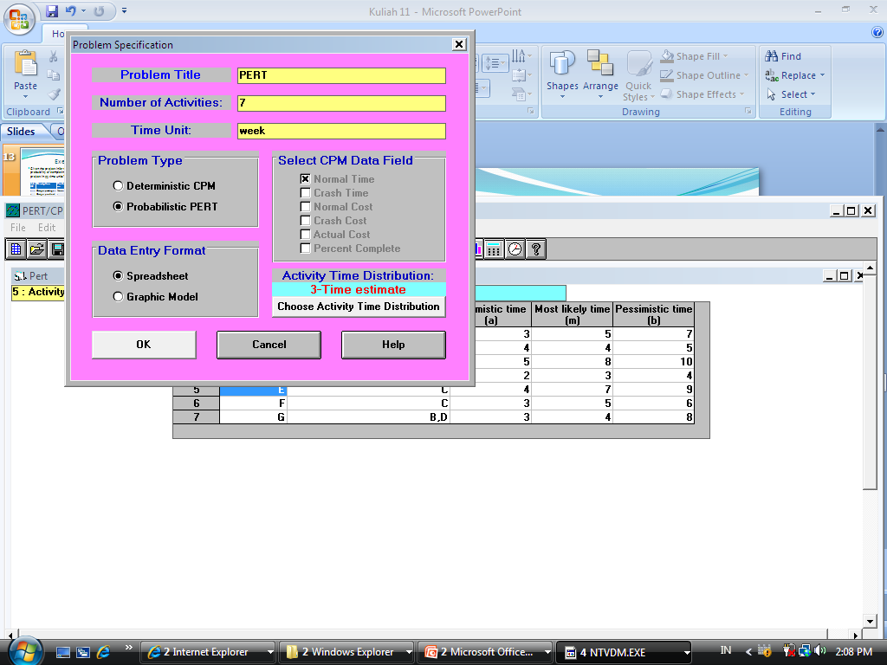
Solve Exercise 1 Using WIN QS

Slide 34
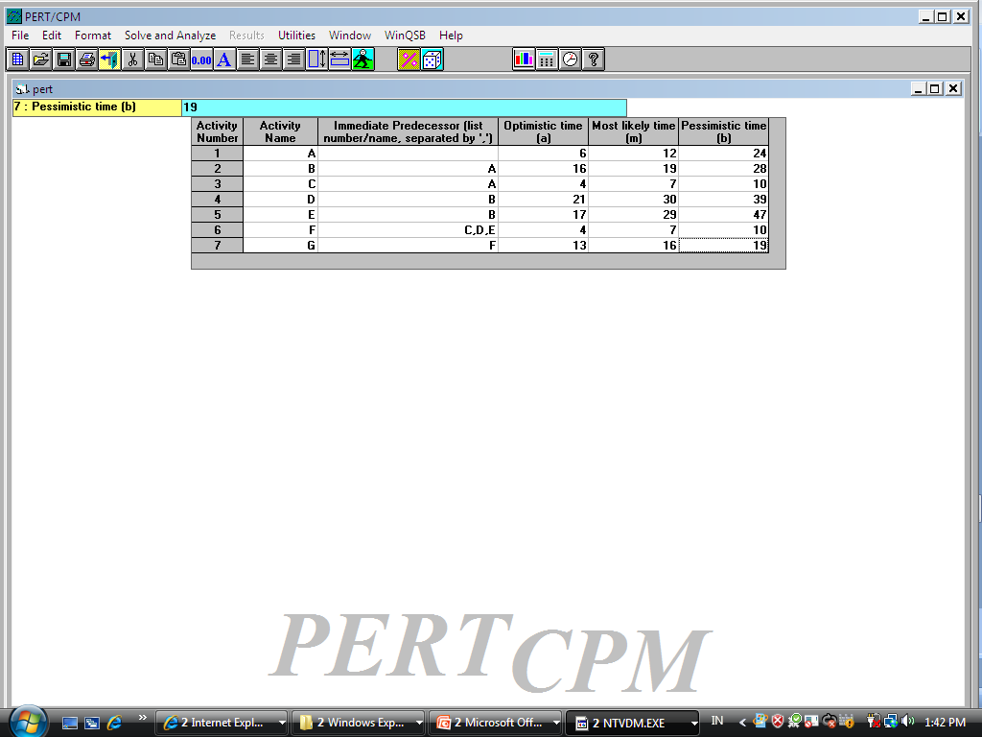
Input the data

Slide 35
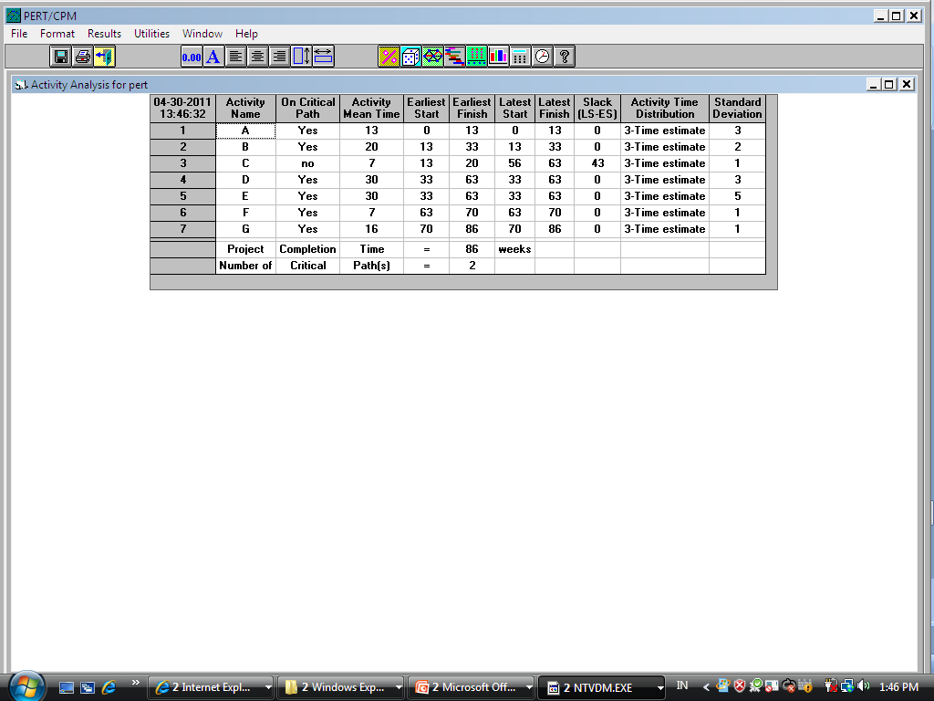
Solve and Analyse – Solve Critical Path

Slide 36
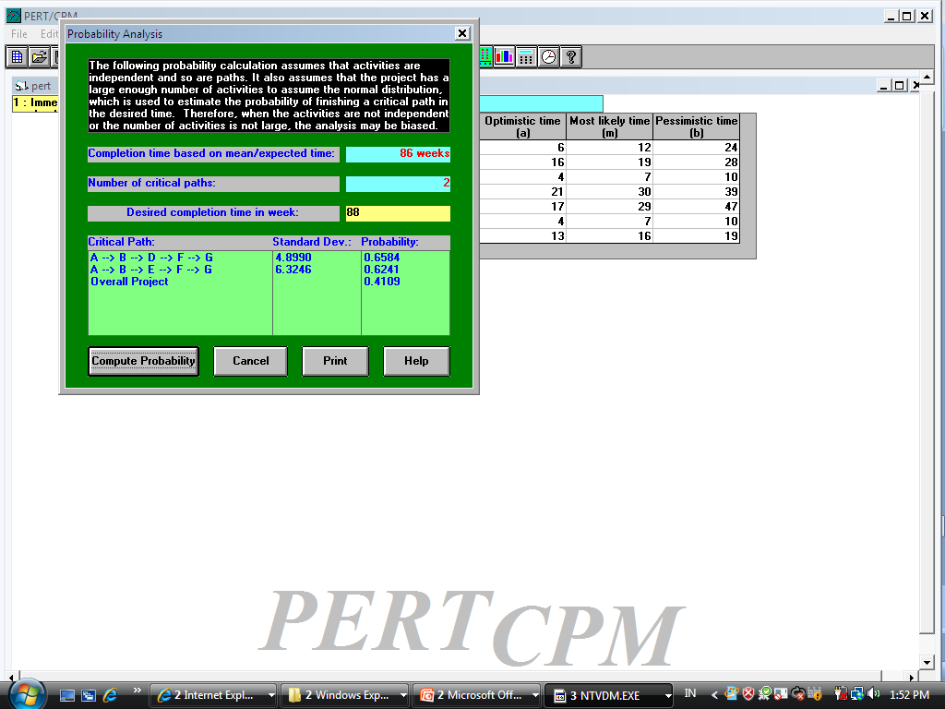
Results – Perform Probability Analysis

Slide 37
Exercise 2
The expected times and variances for the project activities are given below. What is the probability of completing the project in 25 periods?

Slide 38
Exercise 2

Slide 39
Z Values and Probabilities

Slide 40
A-O-N
6 | 4 | 10
0 | TM
6 | 4 | 10
10 | 6 | 26
0 | FP
10 | 16 |  | 26
0 | 1 | 6
0 | PP
0 | 6 | 6
6 | 5 | 16
10 | Patent
16 | 10 |  | 26
26 | 8 | 28
0 | Release
26 | 2 | 28
0 | 2 |  | 7
19 | SCD
19 | 7 | 26
4 | 7 | 7
19 | Ad Pr
23 | 3 | 26
0 | 3 |  | 4
19 | DMP
19 | 4 | 23
CP: 1-4-6-8
T_{E} = 28

Slide 41
A-O-N
  CP: 1-4-6-8
  σT_{E} = √ ∑ (σt_{e} )² = √3+2+10+1 = √ 16 = 4
  Z = TS – TE = 25 - 28 = - 0.75
σ_{TE} √16
P = 0.2275 (22.75 percent)

Slide 42
Project Scheduling
Thank You!
M K Hamirwasia

